Slide 1
Object Capture
작성자 : 김은규

Slide 2
목차
01. Change Log
02. AR Companion
03. Object Capture
04. Reference

Slide 3
01. Change Log
v0.1 : Object Capure 초안 작성(2022.03.24)

Slide 4
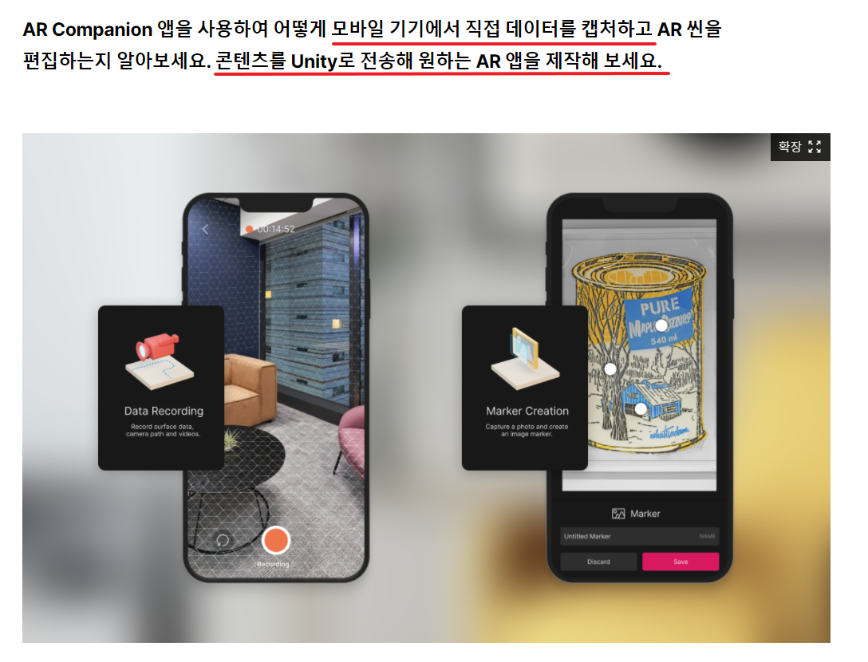
02. AR Companion

Slide 5
02. AR Companion
모바일 기기에서 직접 데이터를 갭처기능 제공
콘텐츠를 Unity로 전송해 원하는 AR앱을 제작 가능

Slide 6
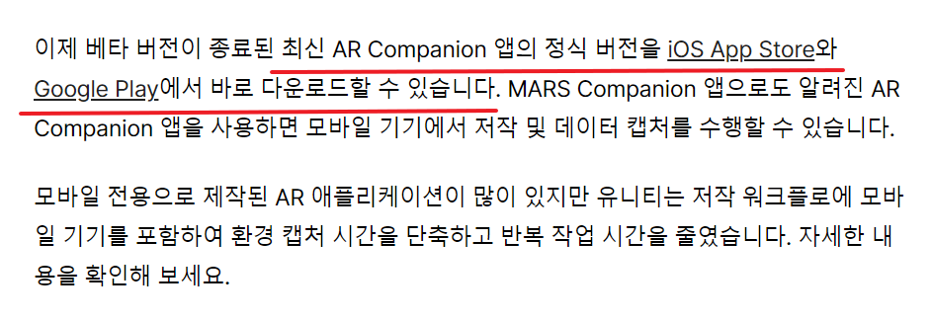
02. AR Companion

Slide 7
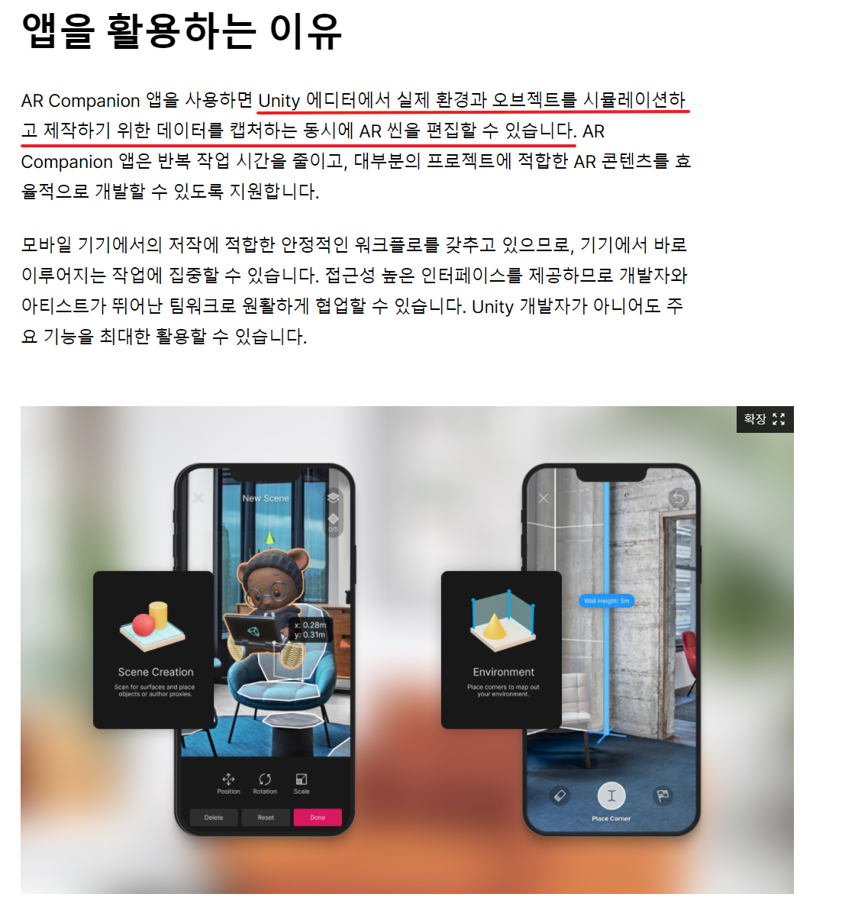
02. AR Companion

Slide 8
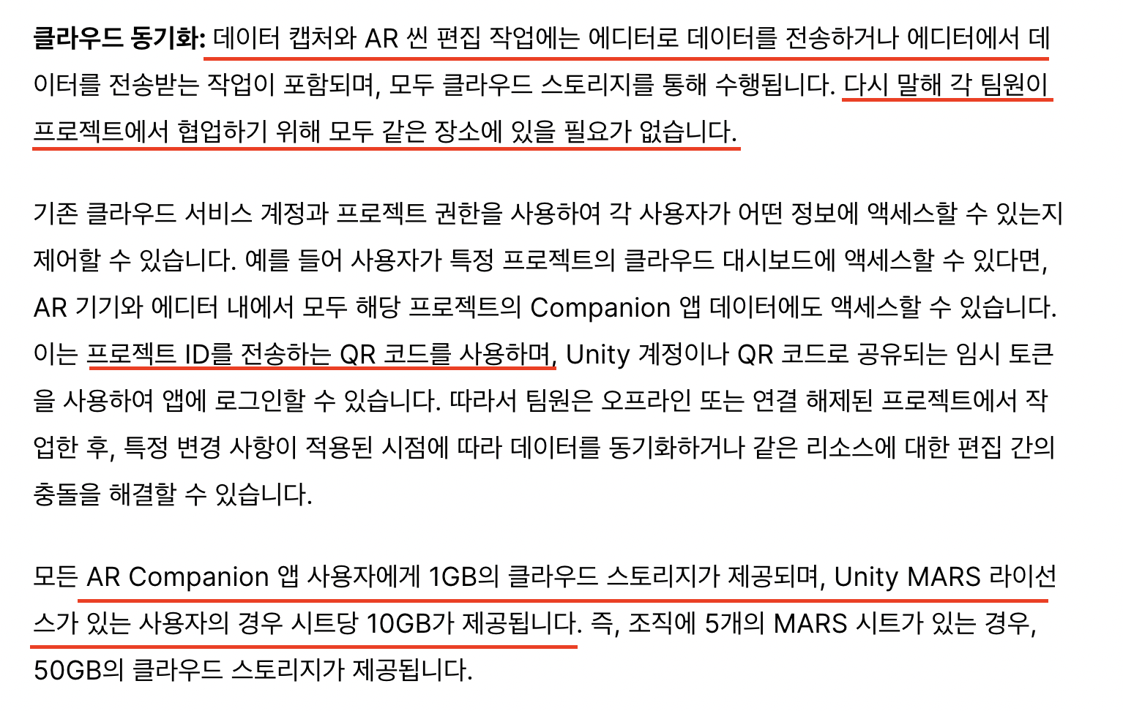
02. AR Companion

Slide 9
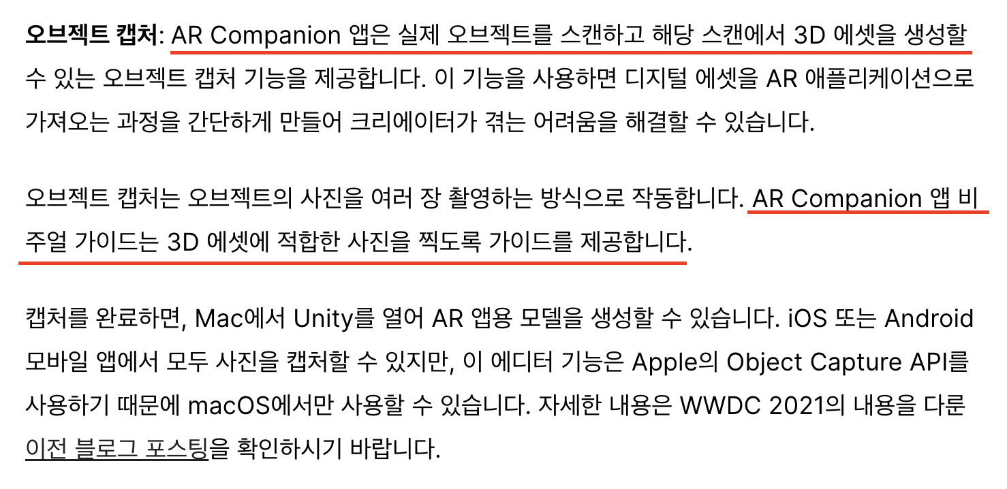
02. AR Companion

Slide 10
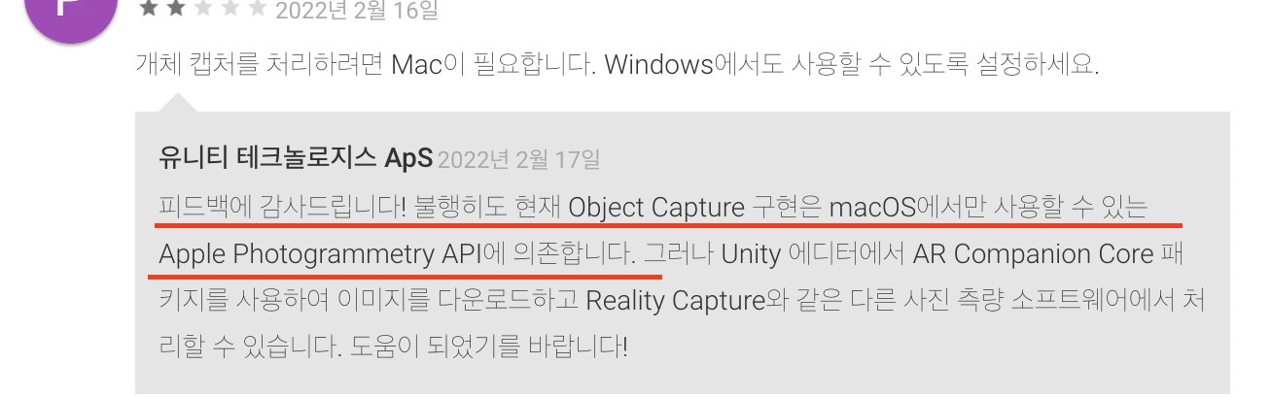
02. AR Companion

Slide 11
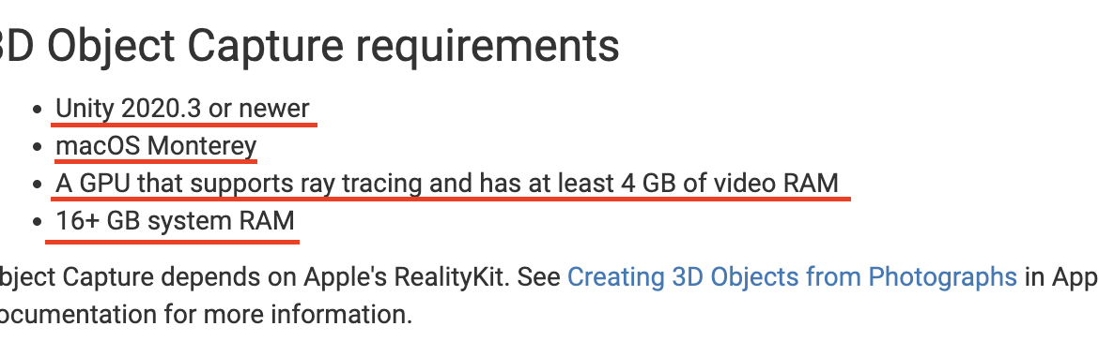
02. AR Companion

Slide 12
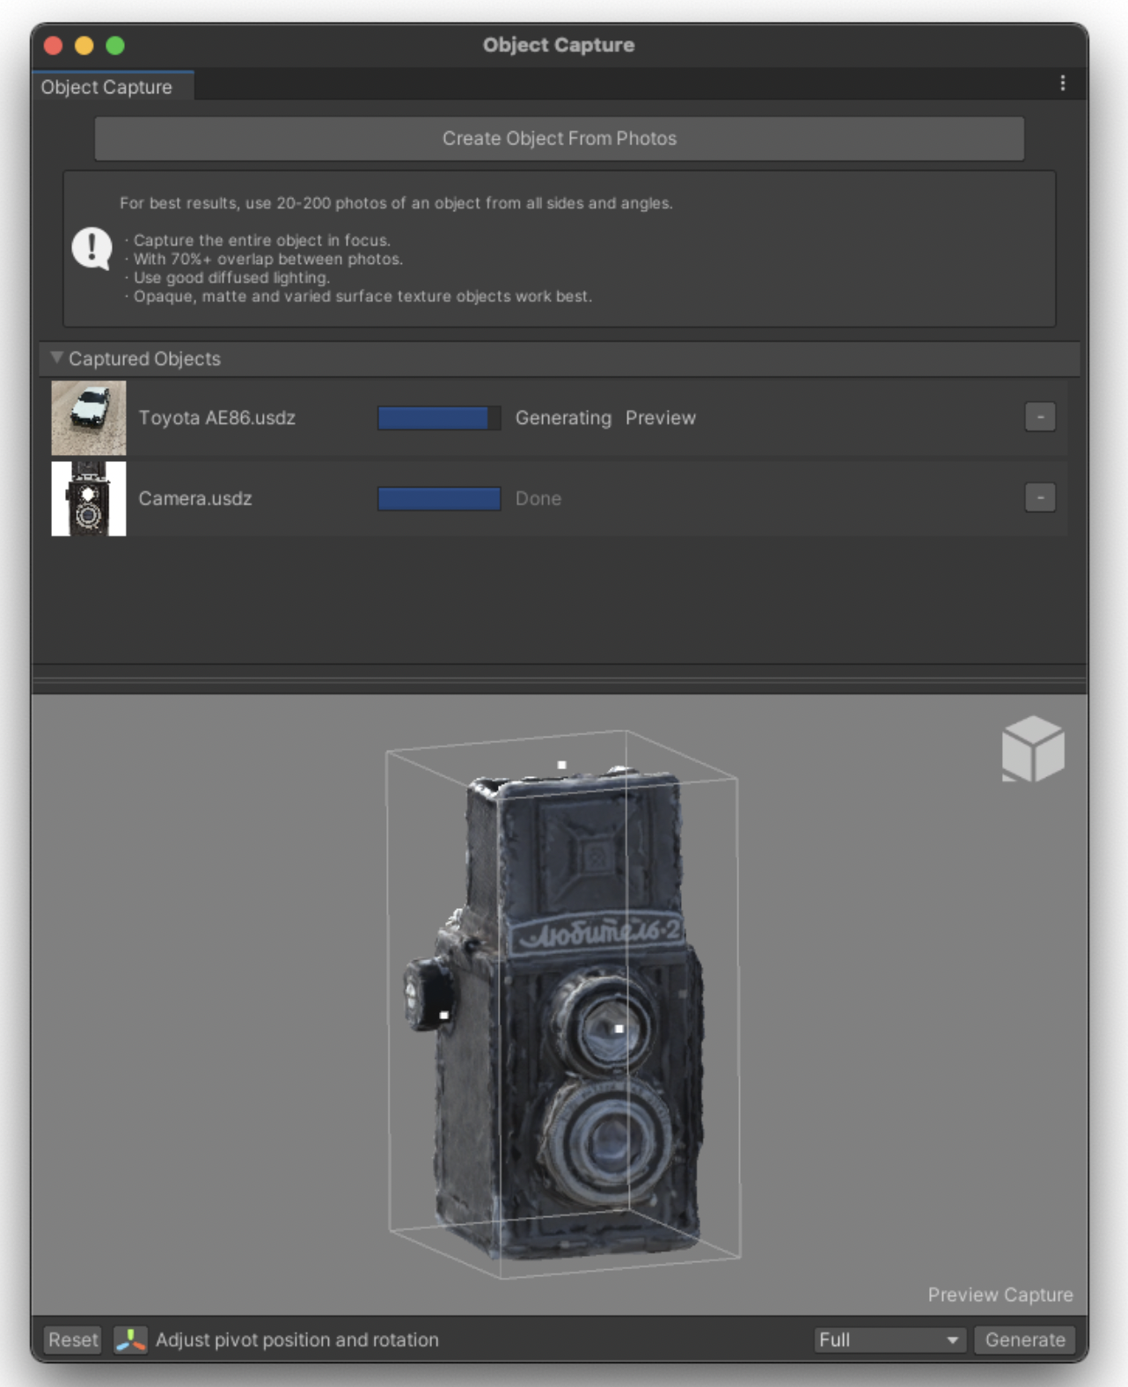
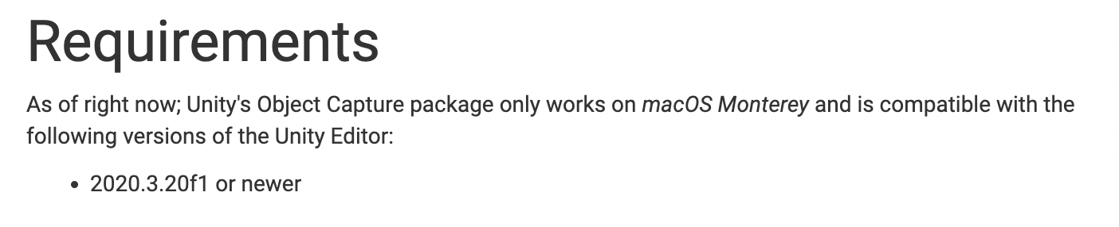
03. Object Capture

Slide 13
04. Reference
P4 ~ P9
https://blog.unity.com/kr/technology/the-ar-companion-app-is-now-available?_gl=1
P10
https://play.google.com/store/apps/details?id=com.unity.ar_companion&hl=en&gl=US
P11
https://docs.unity3d.com/Packages/com.unity.ar-companion-core@1.0/manual/index.html
P12
https://docs.unity3d.com/Packages/com.unity.xr.object-capture@1.0/manual/index.html

